Slide 1

Problems on Change of Variable 2013

Slide 2
Reference
Data
Youtube
Code

Slide 3

[2013]

Slide 4
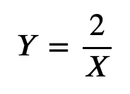

Slide 5


Slide 6


Slide 7
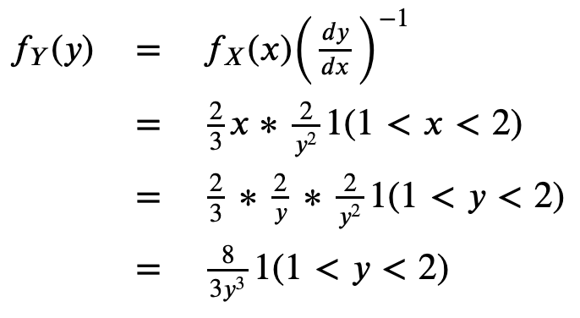

Slide 8
